Slide 1




WELL COME TO
SAKSHI SEVA PRIVATE LIMITED
A natural way of improving your health & Lifestyle.
LAND OF CHANGING LIFE

Slide 2



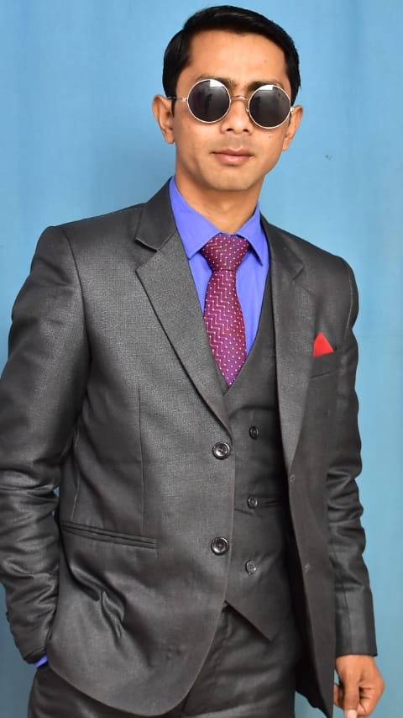



COMPANY FOUNDER
About Company
Sakshi Seva Marketing, we are committed to delivering innovative marketing solutions that drive success for businesses. With a passion for excellence and a customer- centric approach, we help brands grow by leveraging cutting- edge strategies, market insights, and creative campaigns.
Our team consists of experienced professionals dedicated to understanding your business needs and crafting customized marketing solutions. Whether it’s digital marketing, brand promotions, or strategic advertising, we ensure that your message reaches the right audience effectively.
We believe in building long-term partnerships with our clients by offering reliable, results-driven marketing services. At Sakshi Seva Marketing, your success is our priority!
MR JEAMES JYRWA
Our mission is to spread
Health, Wealth & Happiness
Visit Our Website
www.sakshipay.com

Slide 3




Meet Our Directors
Mr. Brajesh kumar singh
Ex Indian Army
15 year direct selling experience Education - Graduate
Mr. Sudhanshu Sekhar
10 year experience in Banking Sector ( field work)
Education - Graduate
REGISTRATION 2013
ON OTT PLATE FORMS
PRODUCT BASE NETWORK
MARKETTING
STARTED ON 2025
Office patna - 800016 .under companies act 1956 PAN,AATCS7693H

Slide 4
Company
Legal Documents

Slide 5
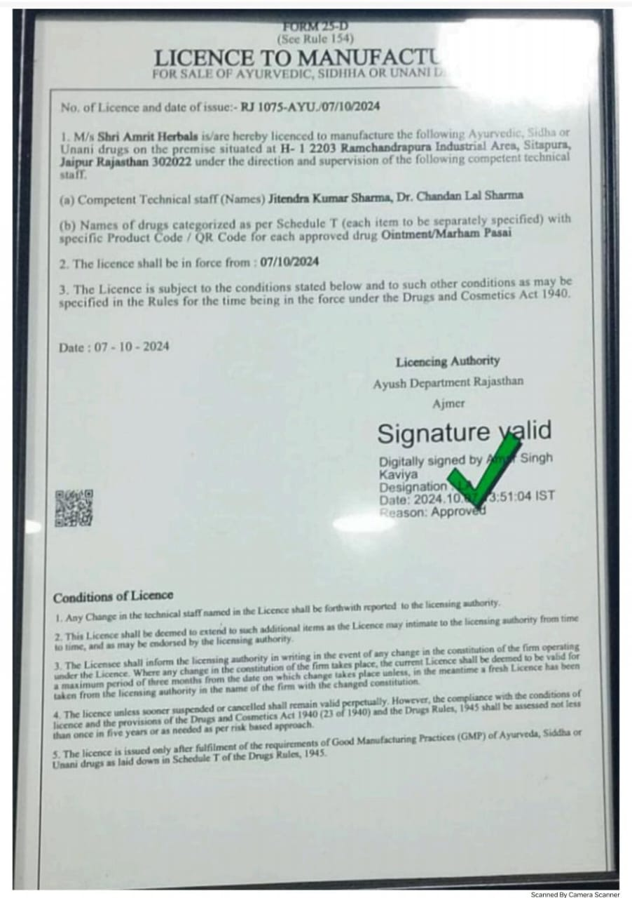
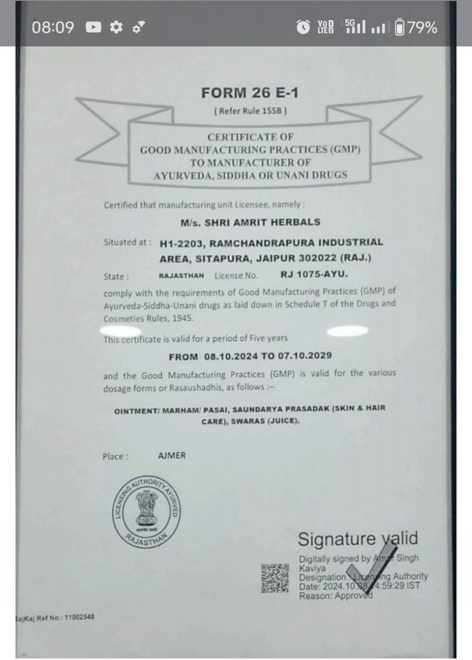
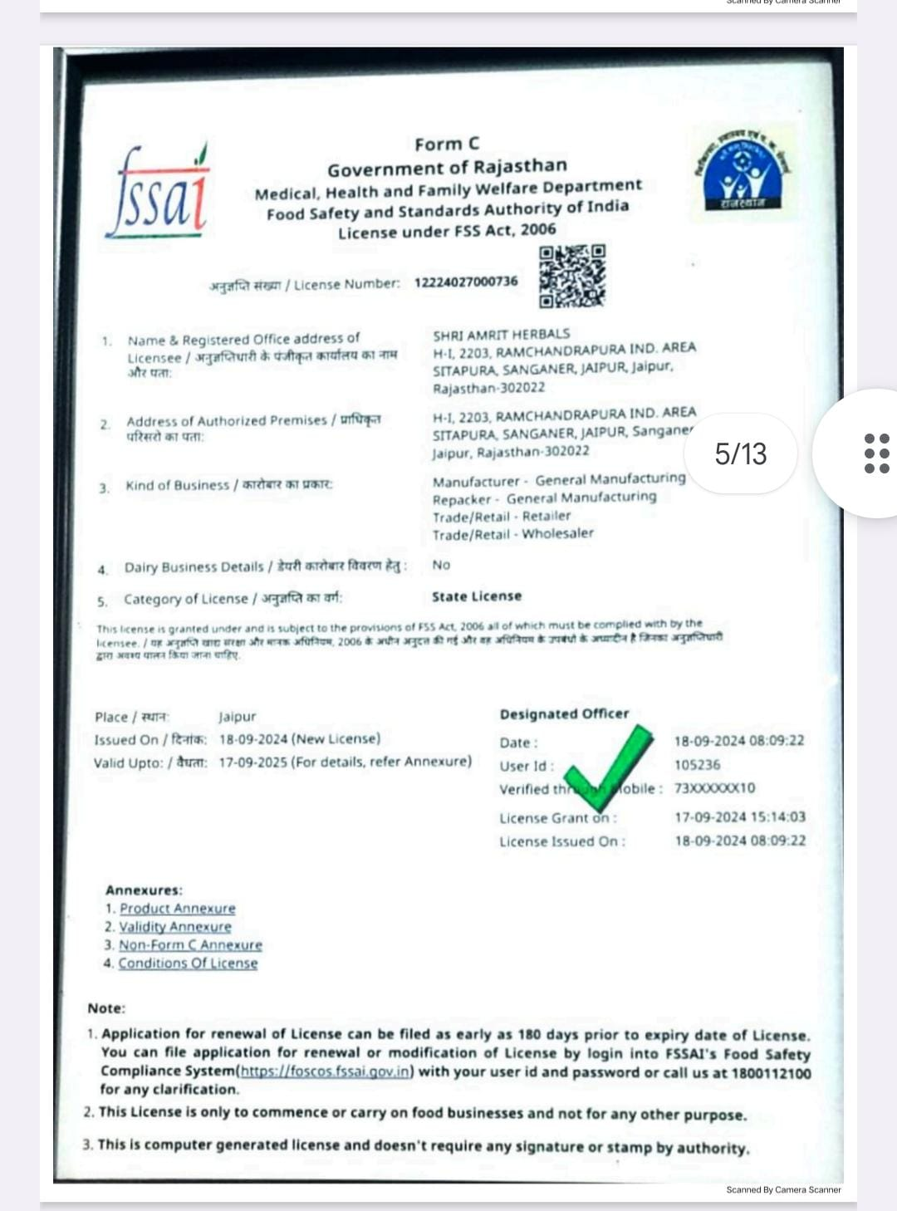
Legal Documents

Slide 6
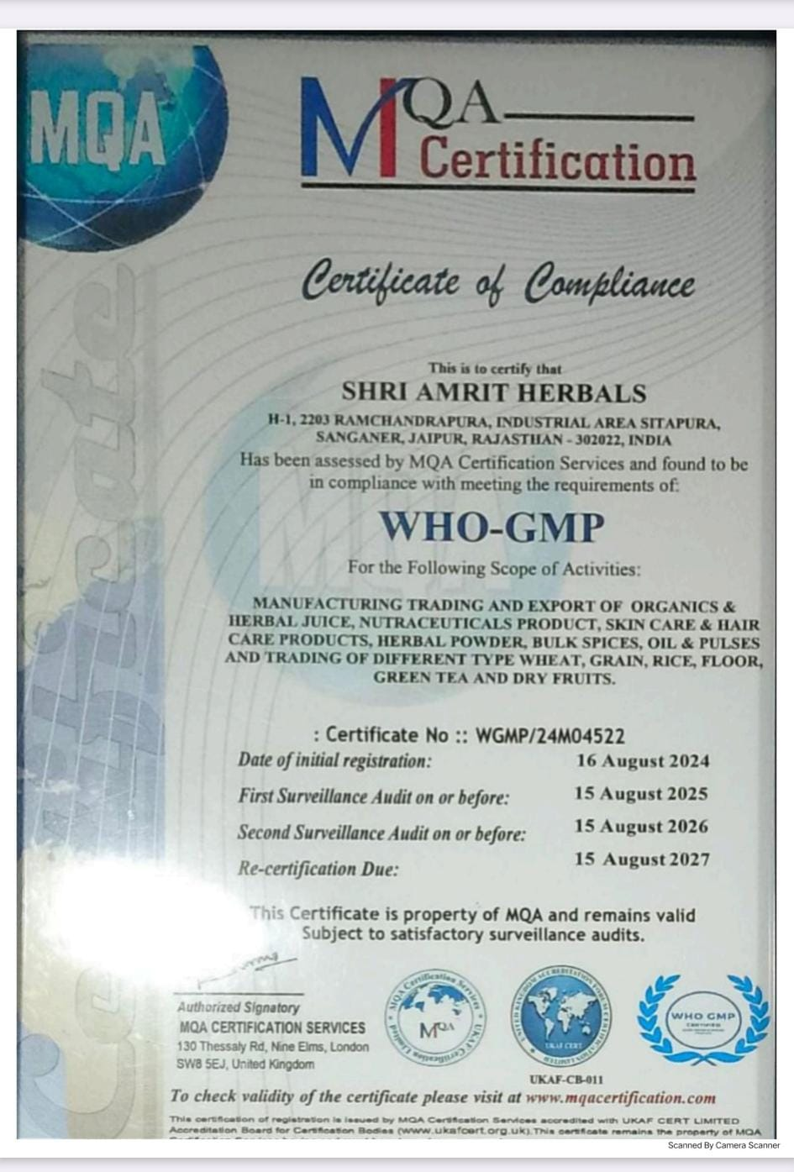
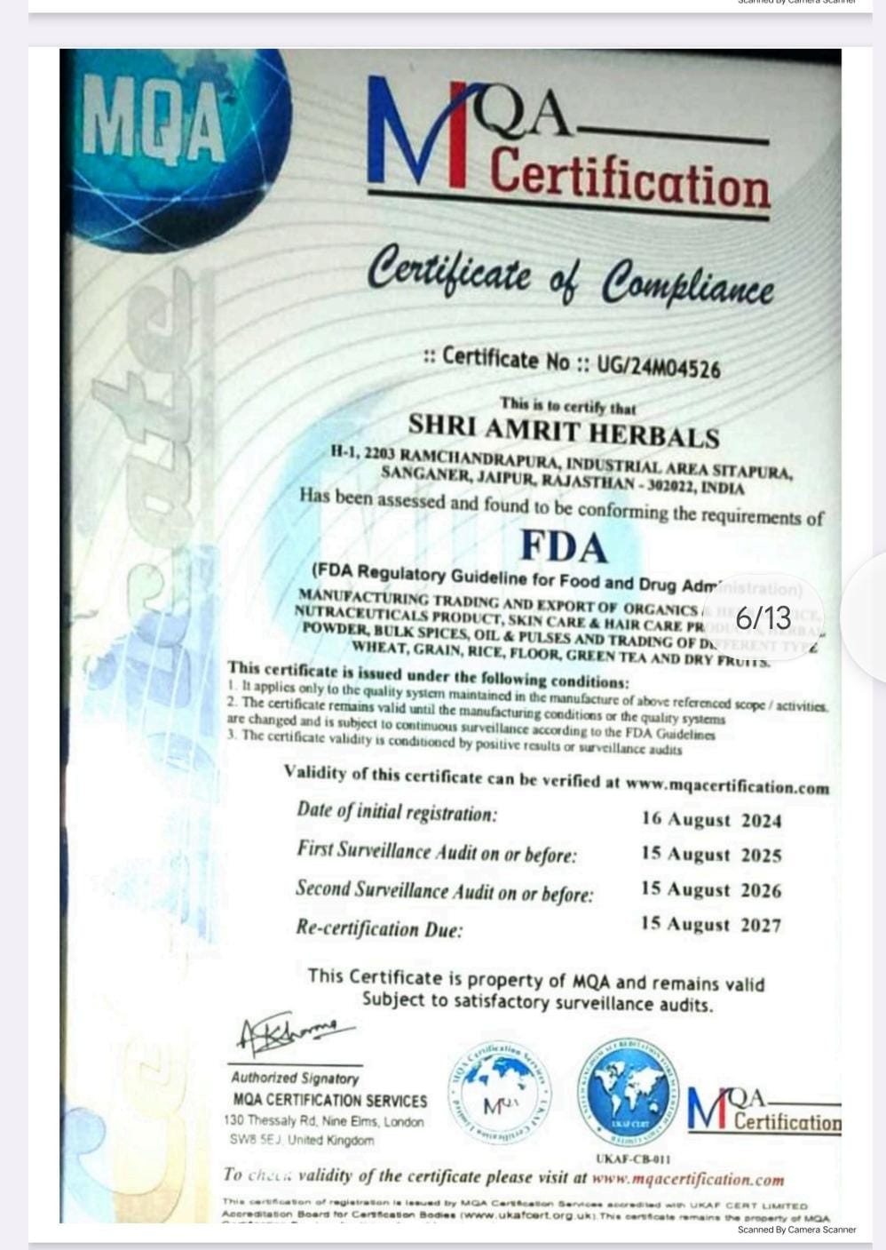
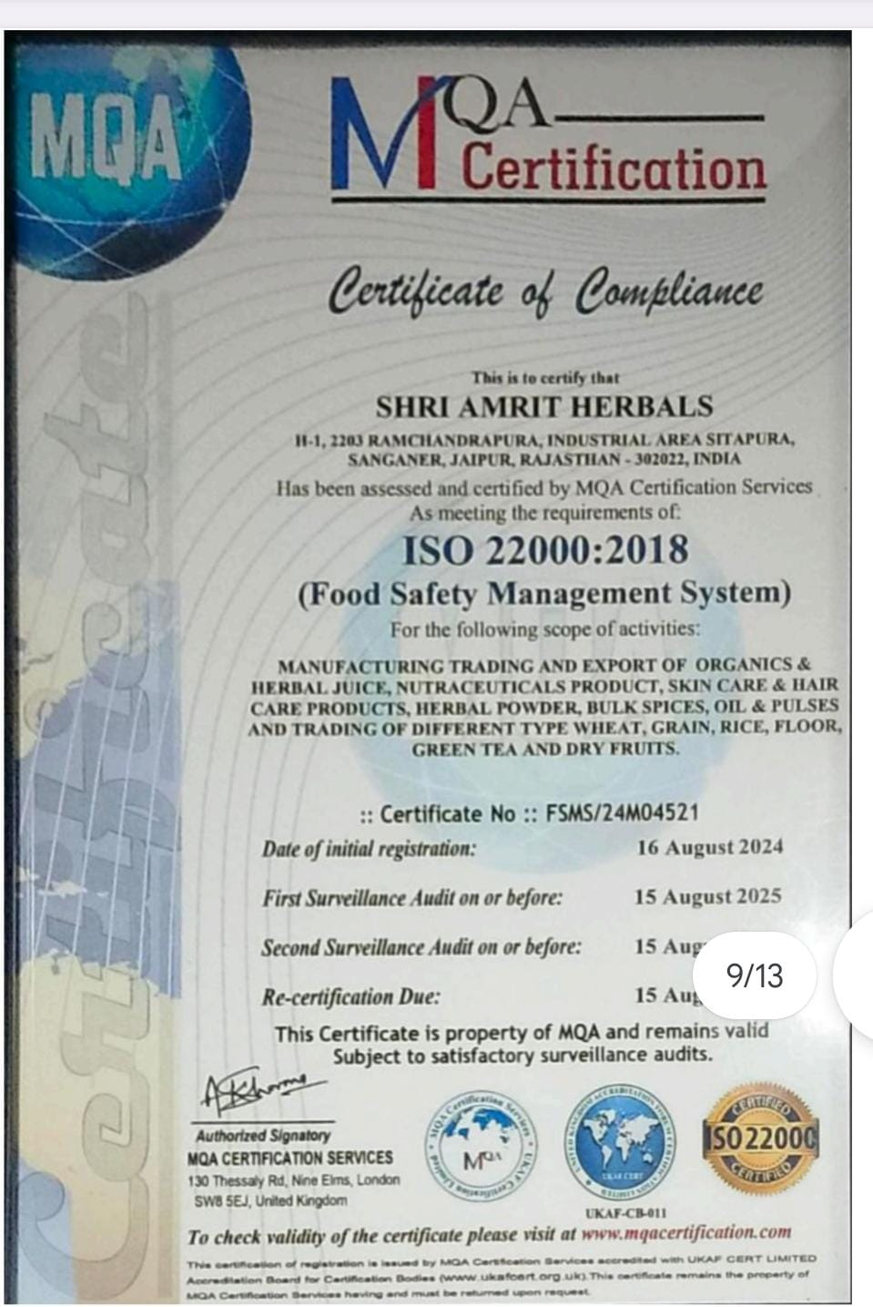
Legal Documents

Slide 7



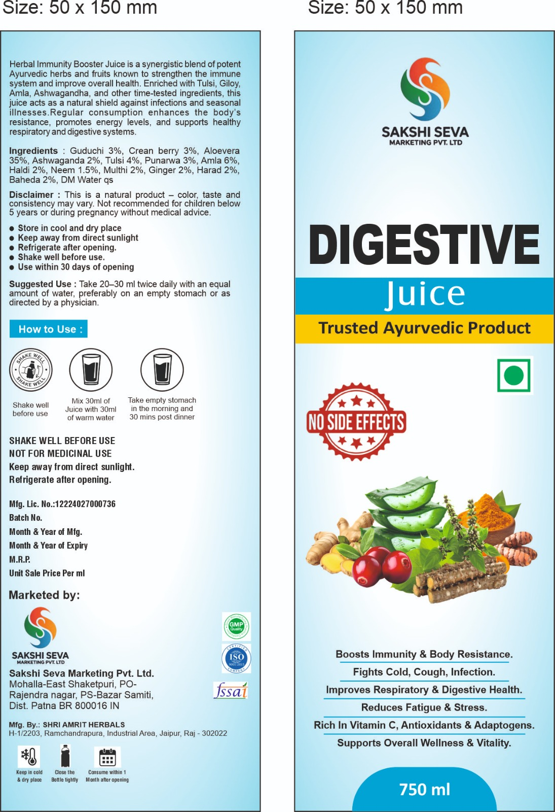
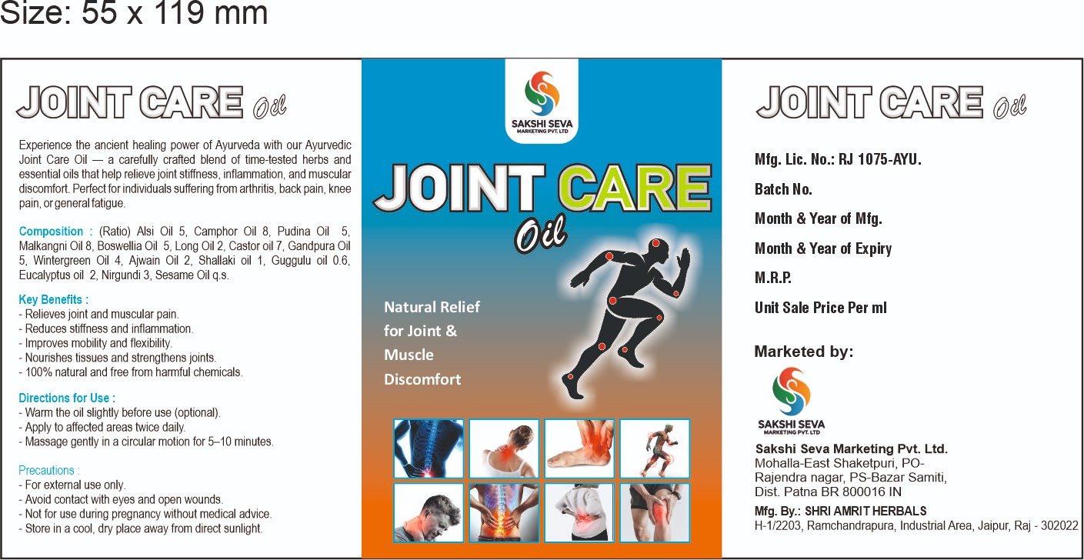
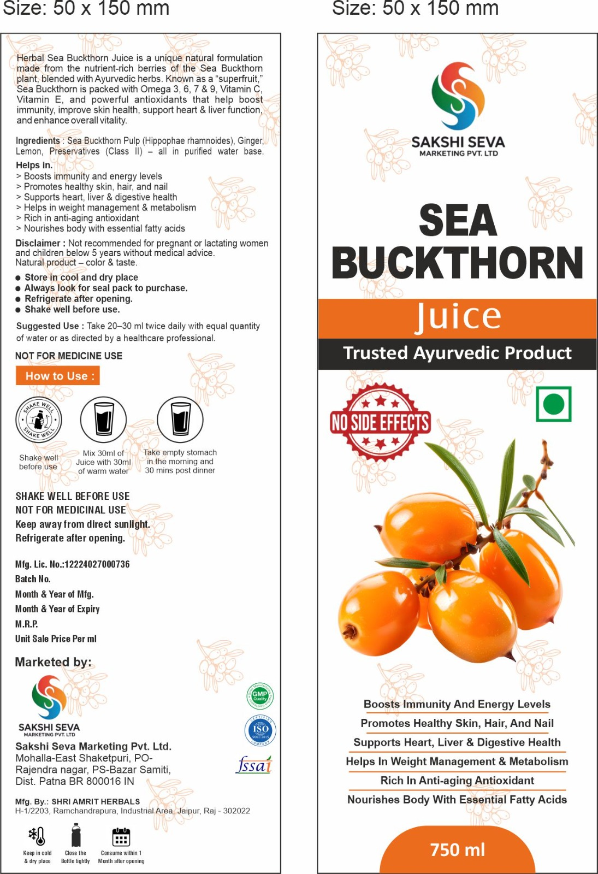
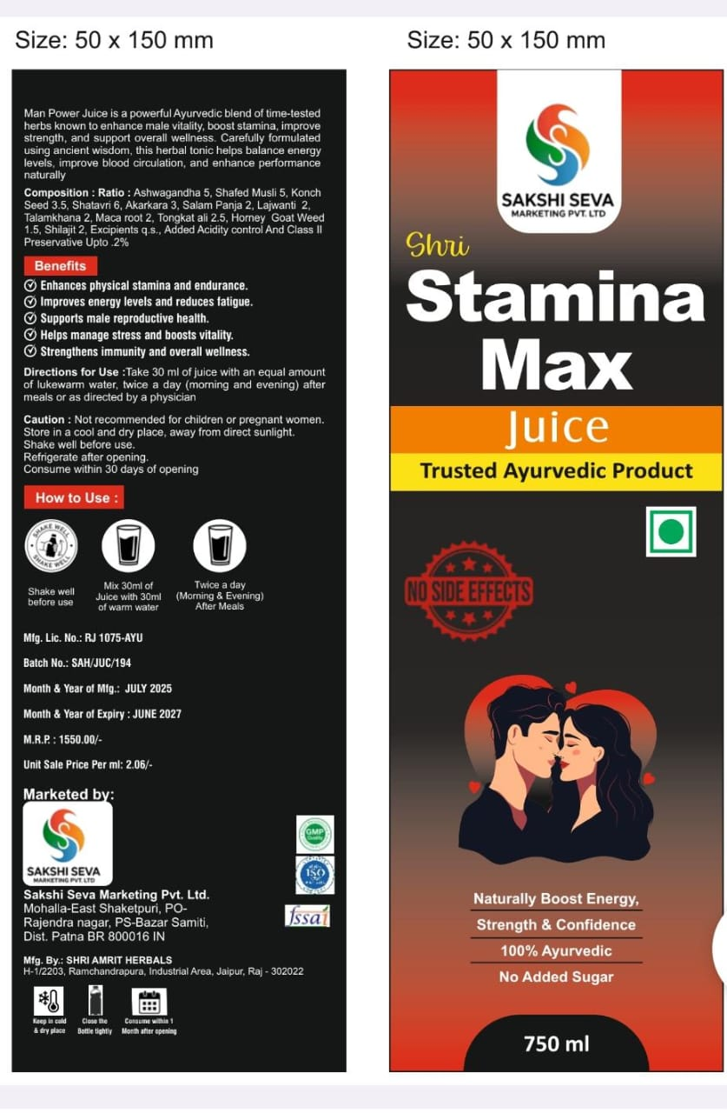
Our Products
DP 550
20pv
DP 300
9pv
25pv
A
6pv
DP 11,00
DP 12,50

Slide 8
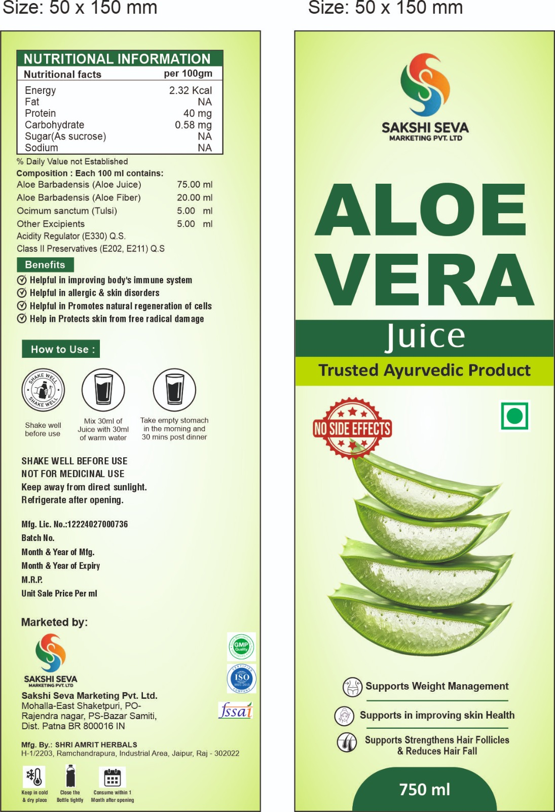
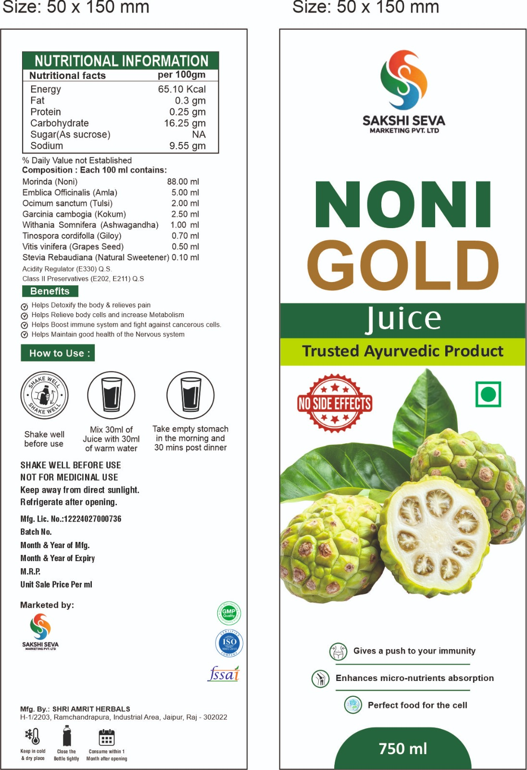


Our Products
6pv
25pv
A
9pv
DP 550
DP 300
DP 12,50

Slide 9









JOINNING PACKAGES
OPPORTUNITY TO EARN SMART
Rs 5000/-
100 pv
Rs 2500/-
50 pv
RS .10000 /- 200 PV
CONTACT . 9366942450

Slide 10



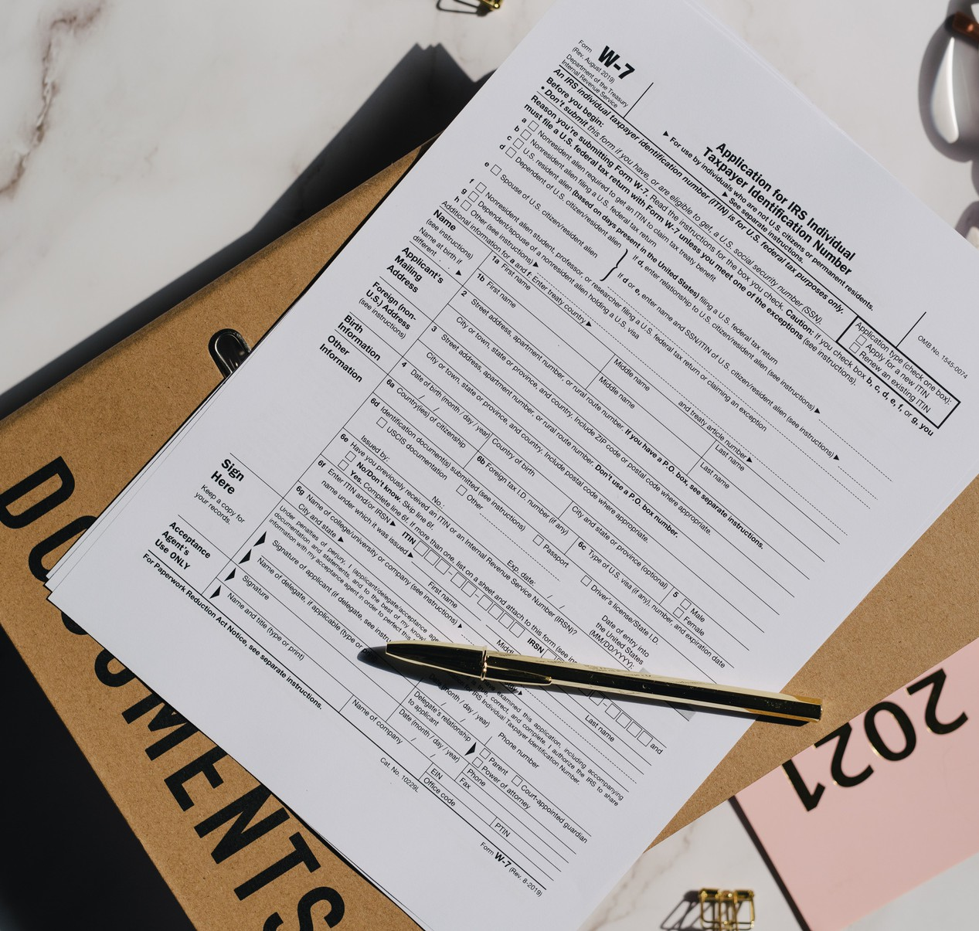


TYPE OF INCOME
SELF MOB RECH COMMISSION 3.5%
DIRECT REFERRAL COMMISSION
TEAM LEVEL COMMISSION
Change your life
REWARD & TOUR
Daily payout
RETAIL PROFIT

Slide 11


Distribution chart
TEAMES INCOMES
200PV
50PV
100 PV
Level |  |  |  | Teames
1 | 2000 | 1000 | 500
2 | 400 | 200 | 100
3 | 200 | 100 | 50
4 | 120 | 60 | 30
5 | 80 | 40 | 20
6 | 40 | 20 | 10
7 | 40 | 20 | 10
8 | 40 | 20 | 10
9 | 40 | 20 | 10
10 | 40 | 20 | 10
11-15 | 40 | 20 | 10
100PV
5 | 5,000
25 | 5,000
125 | 12,500
625 | 37,500
3125 | 125,000
15625 | 312,500
78125 | 1,562,500
390625 | 7,812,500
1953125 | 39,062,500
9765625 | 195,312,500
Cont | Cont
AFTER 15 LEVEL ONWARD RS 5 , REPURCHASE COMPULSORY

Slide 12



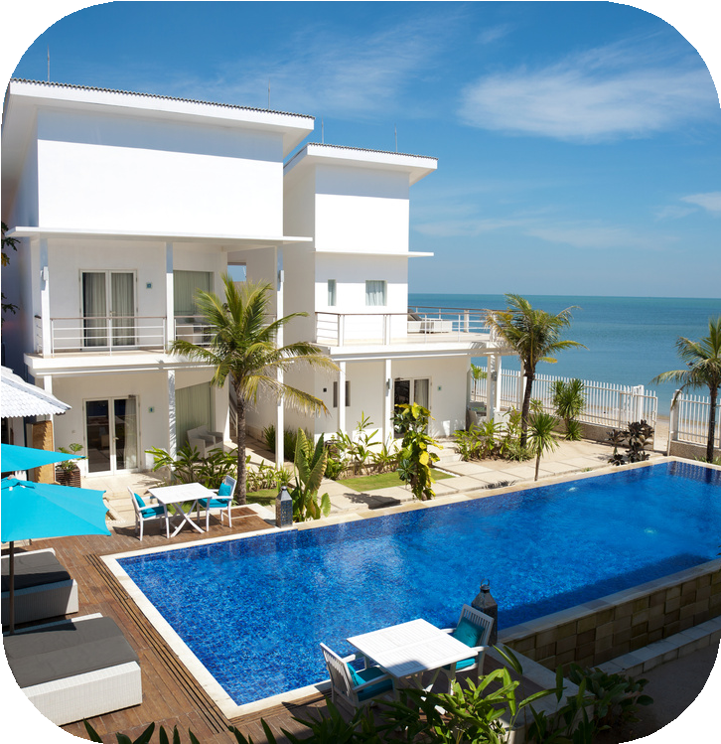
RANK REWARDS
MINIMUM INCOME AND REWARDS
Rank
Team
DIRECT
INCOMES
REWARDS
BRONZE
15 Direct
15,000
SILVER
75
5
20,000
MOBILE
GOLD
375
10
47,500
LAPTOP
PLATINUM
1875
20
132,500
5LK, CAR FUND THAILAND TOUR
DIAMOND
9375
40
415,000
15LK,CAR FUND MALASYIA TRIP
D-DIAMOND
46875
80
10,17,500
60LK, HOUSE FUND DUBAI TRIP
AMBASSADOR
234375
160
48,47,500
1.5 CR ROYAL FUND SWERZELAND TRIP
NOTE.1 JOINING ACCORDING 100PVRS 4999. 100PV

Slide 13

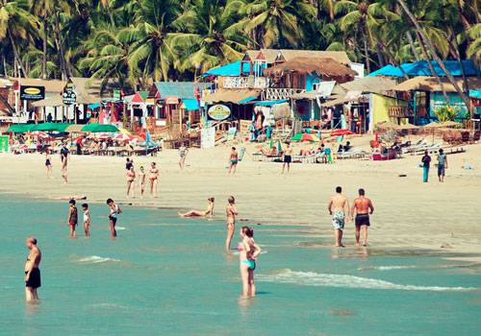









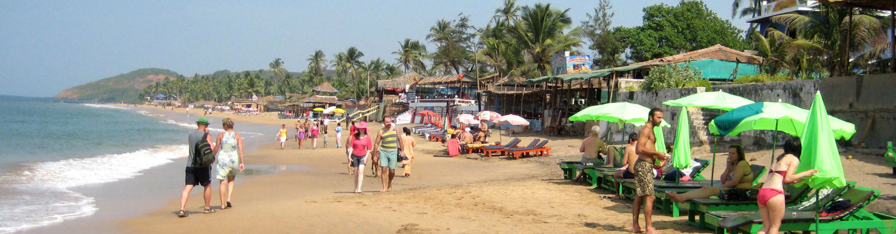
DHAMAKA TARGET
45 DAYS
ONE SIDE FLIGHT TICKET
50 pv
60
100 pv
30
200 pv
15
1 AUG TO 15 SEP

Slide 14

The best preparation for tomarrow
Is doing your best today
Success is simple.
Do what’s right, the right way, at the right time
Thank you, wish you All the best
CONTACT . 9366942450
In the end, we only regret the chances we didn’t take
DESIGNED BY JEAMES JYRWA

